Slide 1

Problem Contextualisation Oral Presentation
Distributed IoT environmental monitoring
FJ Fourie 26047799

Slide 2
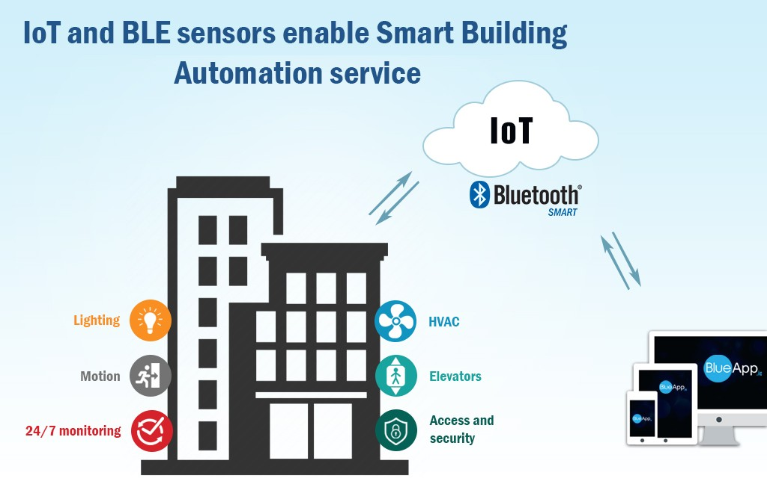
Context and analysis of the problem:
HVAC Monitoring System
Components
Heating
Ventilation
Air Conditioning
Other
Lights
Doors

Slide 3
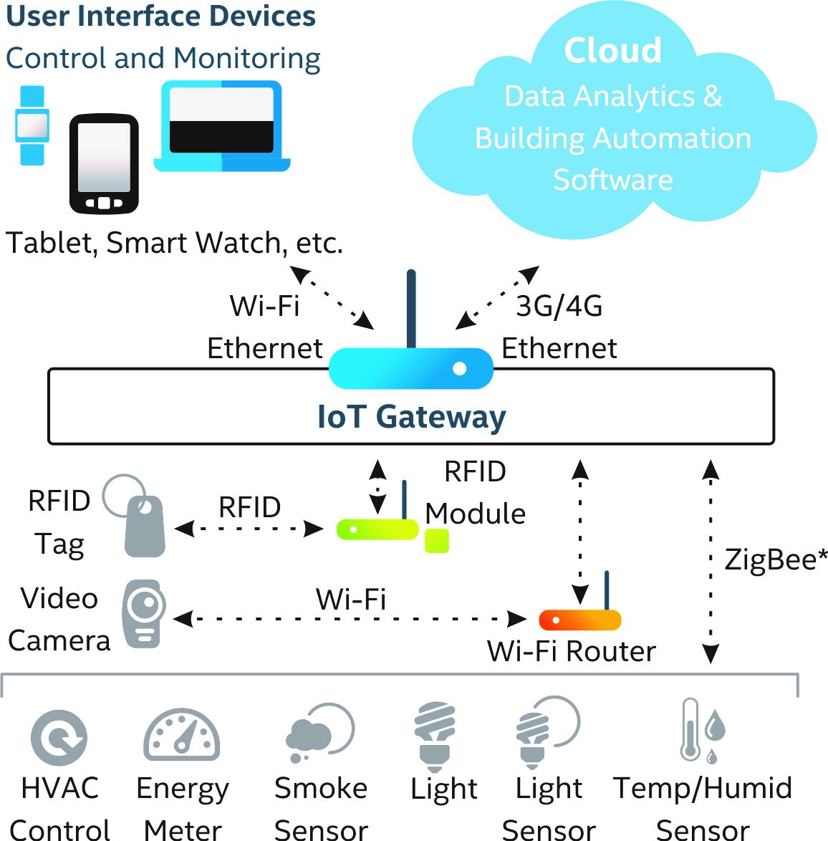
Context and analysis of the problem:
Internet of things
Real-Time Monitoring
Predictive Maintenance
Remote Diagnostics
Total Controllability
Increased Efficiency

Slide 4
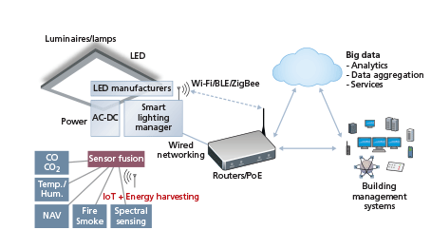
The problem:
Sensor installation
Sensor communication
Communication with cloud
Data processing
Respond to data

Slide 5
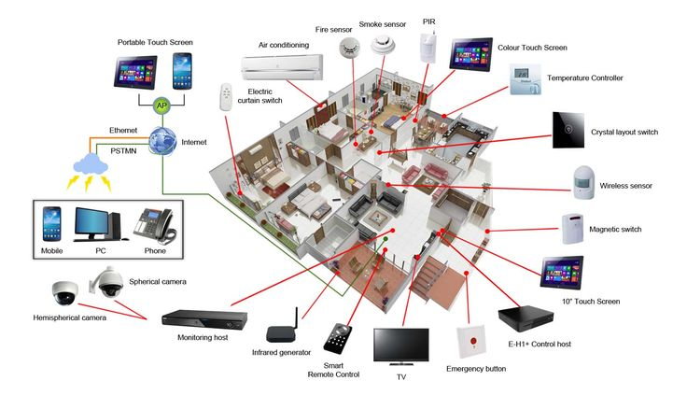
Project objective:
HVAC sensor system
Link to cloud
Data analysis
Results shown

Slide 6
THE END

